Slide 1
Institutional Repositories
Dr.G.SAROJA
Asst. Professor
DLIS, BRAOU

Slide 2
INTRODUCTION
Research is the primary function of Academic & Research institutions and they are producers of primary research
Research degrees
Research projects
Publications
Conference proceedings etc.

Slide 3
SCHOLARLY COMMUNICATION
Traditionally, publishers are doing the task of disseminating research output through the scholarly journals in various disciplines
Scholarly communication has been described as comprising four essential components:
Registration—establishing the intellectual priority of an idea, concept, or research;
Certification—certifying the quality of the research and/or the validity of the claimed finding;
Awareness—ensuring the dissemination and accessibility of research, providing a means by which researchers can become aware of new research; and
Archiving—preserving the intellectual heritage for future use.6

Slide 4
Traditional Publishing Model
In the traditional publishing, Faculty researchers produce the original research itself; academic editors and peer-reviewers select and validate the quality and priority of the research; academic libraries process, house, and distribute the journals to end users; and library resources support archival preservation—all at little or no direct cost to the journal publishers themselves.

Slide 5
Traditional Model
The publisher contribution to the scholarly publishing value chain concentrated on the distribution component: typesetting, printing, marketing, and fulfilment were specialized and expensive tasks that authors and libraries gladly delegated to publishers. With the evolution of digital publishing and networked distribution technologies, the relative value of print production and distribution has declined.

Slide 6
Scholarly communication in the changing times
Due to the growing dissatisfaction among the academics, librarians regarding the spiraling costs of the print journals and realizing the limited role of the publishers in the process of scholarly communication, Open Access Initiatives have come into existence.
It is felt that any institution with sufficient intellectual prestige and organizational standing can take up the role of publishers. Institutional Repositories thus have gained prominence in the changing technological environment.

Slide 7
Factors that led to the development of IRs
Several coinciding factors are forcing change in the structure of scholarly journal publishing:
Technological change, in the form of digital publishing technologies and ubiquitous networking, has driven the demand for broader access to research and for more robust digital presentation.
Significant increases in the overall volume of research, especially in the sciences, has strained the capacity of the print publishing model and exacerbated user dissatisfaction with the latency inherent in print publication.
Increasing dissatisfaction, especially on the part of librarians, with traditional print and electronic journal price and market models—models that have become less relevant and more difficult to sustain in a period of rapidly escalating prices and relatively flat library budgets.
Increasing uncertainty over who will handle the preservation archiving of digital scholarly research material.

Slide 8
Institutional Repositories – definitions
An Institutional repository is an Organization based set of services which the organization offers to the members of its community for the management and dissemination of digital materials created by the institution and its community members. It is most essentially an organizational commitment to the stewardship of these digital materials, including long-term preservation, where appropriate, as well as organization and access or distribution” (Clifford Lynch 2003)
“Digital archives of intellectual products created by the faculty, staff and students of an institution or group of institutions accessible to end users both within and outside the institution.”

Slide 9
CHARACTERISTICS OF IRs
Crow (2003) and Johnson (2002) have identified four charateristics of IR. They are -
Institutionally based
Scholarly material in digital formats
Cumulative and perpetual
Open and interoperable
But not necessarily be free!

Slide 10
CHARACTERISITICS OF IR – INSTITUTIONAL
Institutional Repository should focus on the content created by its constituent members. The materials could be of any one of the digital output including preprints, journal articles, lectures, learning objects and data sets etc.

Slide 11
CHARACTERISTICS OF IR
The content should be scholarly in nature. When the material is openly accessible by the members of the community, the content should facilitate and promote further research and add to the knowledge base. The materials included in an IR can be peer reviewed journal articles, project reports funded by govt. agencies, computer programs, art works – virtually any digital material the institution wishes to preserve for the future use.

Slide 12
CHARACTERISTICS OF IR
While creating IR the institution must develop policies to ensure that the infrastructure used to develop IR is scalable. That is, every year, lot of material will be added to the IR. Eventually, the IR should be able to store large volume of data may be in terra bytes. (Cumulative)
Once the material is deposited in the IR it can not be withdrawn unless in certain cases such as copyright infringements or plagiarism etc. However, the institutions must develop criteria and policies—and implement rights management systems—for allowing access to a repository’s content, both inside the institution and from outside, that balance the goal of the broadest available access with the reality of encouraging faculty participation.
(perpetual) IR ‘s aim to preserve and make accessible digital content on a long-term basis. The Inst. Therefore should set some standards for submission of materials by its members like – simplifying the content submission in specified file formats.

Slide 13
Characteristics of IR
Inter-operable: (the ability to exchange and use information) "Interoperability is the ability of multiple systems with different hardware and software platforms, data structures, and interfaces to exchange data with minimal loss of content and functionality" [NISO, 2004].
In order to increase the repository access and visibility to broader research community, the IT should be able to support interoperability in order to provide access via multiple search engines and other discovery tools. It is not compulsory to implement searching and indexing functionality but IR should maintain and expose metadata, allowing other services to harvest and search the content.

Slide 14
Why Institutional Repositories?
Institution’s visibility: IR not only serves as an indicator of quality in teaching and research but also enhances its opportunities to attract funding and advancement of research.
Digital Preservation: With the advent of robust technology, IR facilitates long term preservation of the digital content.
Open Access:

Slide 15
WHY INSTITUTIONAL REPOSITORIES
For the Individual
Provide a central archive of their work
Increase the dissemination and impact of their research
Acts as a full CV
For the Institution
Increases visibility and prestige
Acts as an advertisement to funding sources, potential new faculty and students, etc.
For Society
Provide access to the world’s research
Ensures long-term preservation of institutes’ academic output

Slide 16
WHY INSTITUTIONAL REPOSITORIES
Individual Benefits
Wider distribution
Showcase
Safekeeping
Lowers technology barrier
Time
Persistent URLs

Slide 17
WHY INSTITUTIONAL REPOSITORIES
Institutional Benefits
Stewardship of scholarly output
Efficiencies through centralization
Showcase
Proactive response to scholarly communication crisis/open access movement

Slide 18
Examples of IR : Univ. of California eScholarship Repository : http://escholarship.org/

Slide 19
Examples of IR : Project SHERPA – UK http://www.sherpa.ac.uk/

Slide 20
Examples of IR : Cornell Industrial and Labor Relations School http://digitalcommons.ilr.cornell.edu/

Slide 21
Examples of IR :University of Massachusets http://scholarworks.umass.edu/

Slide 22
Digital Commons at University of Maryland Law: http://digitalcommons.law.umaryland.edu/

Slide 23
Scientific Research in India
The third largest scientific and technical manpower in the world
Exclusive Government Departments for Science & Technology, Atomic Energy, Space, Electronics, Oceanography, Biotechnology…
Over 300 Research Laboratories belonging to CSIR, ICMR, ICAR, ICSSR, DRDO, ISRO…
Education/Science performed by IISc, IITs, NITs, IIMs…and most of the Medical/ Engineering/Business Schools, Universities and research labs are of international standards

Slide 24
INSTITUTIONAL REPOSITORIES:INDIAN SCENARIO
Nearly 50 Institutions
Public Domain (Internet): 35
Campus Network/LAN : 15
Leading IRs
IISc, ISI, NAL, NCL, NIO, RRI, DU, IITs

Slide 25
Table 10: Indian IRs Listed by ROAR
Sl.
No.
Name
Host Institution
URL
Items Jan
2008
Soft. Used
1.
Eprints@IISc
Indian Institute of Science, (IISc) Bangalore.
http://eprints.iisc.ernet.in/
7672
EPrints
2.
Dspace@IIMK
Indian Institute of Management, Kozhikode (IIMK)
http://dspace.iimk.ac.in/
295
EPrints
3.
Dspace@IIA
Indian Institute of Astrophysics (IIA)
http://prints.iiap.res.in/
1903
DSpace
4.
Dspace@NITR
National Institute of Technology,
Rourkela (IITR)
http://dspace.nitrkl.ac.in/dspace/
557
DSpace
5.
ETD@IISc
Indian Institute of Science (IISc)
http://etd.ncsi.iisc.ernet.in/
289
DSpace
6.
Dspac@
INFLIBNET
INFLIBNET
http://dspace.inflibnet.ac.in
504
DSpace
7.
Librarian's Digital
Library (LDL)
Docum. Res. &
Training Centre (DRTC)
https://drtc.isibang.ac.in/
249
DSpace
8.
NAL Institutional
Repository
Nat. Aerospace Laboratories (NAL)
http://nal-ir.nal.res.in/
2575
EPrints
9.
ETheses at NCL
Nat. Chemical Laboratory (NCL)
http://dspace.ncl.res.in/
407
DSpace

Slide 26
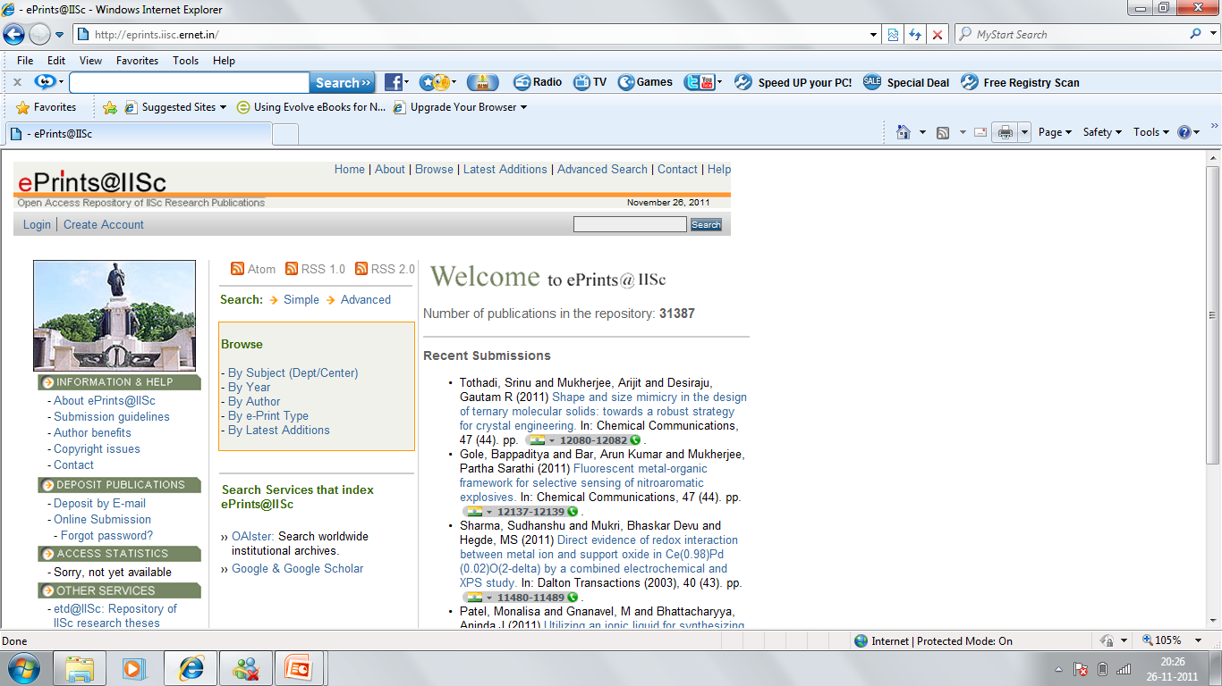

Slide 27
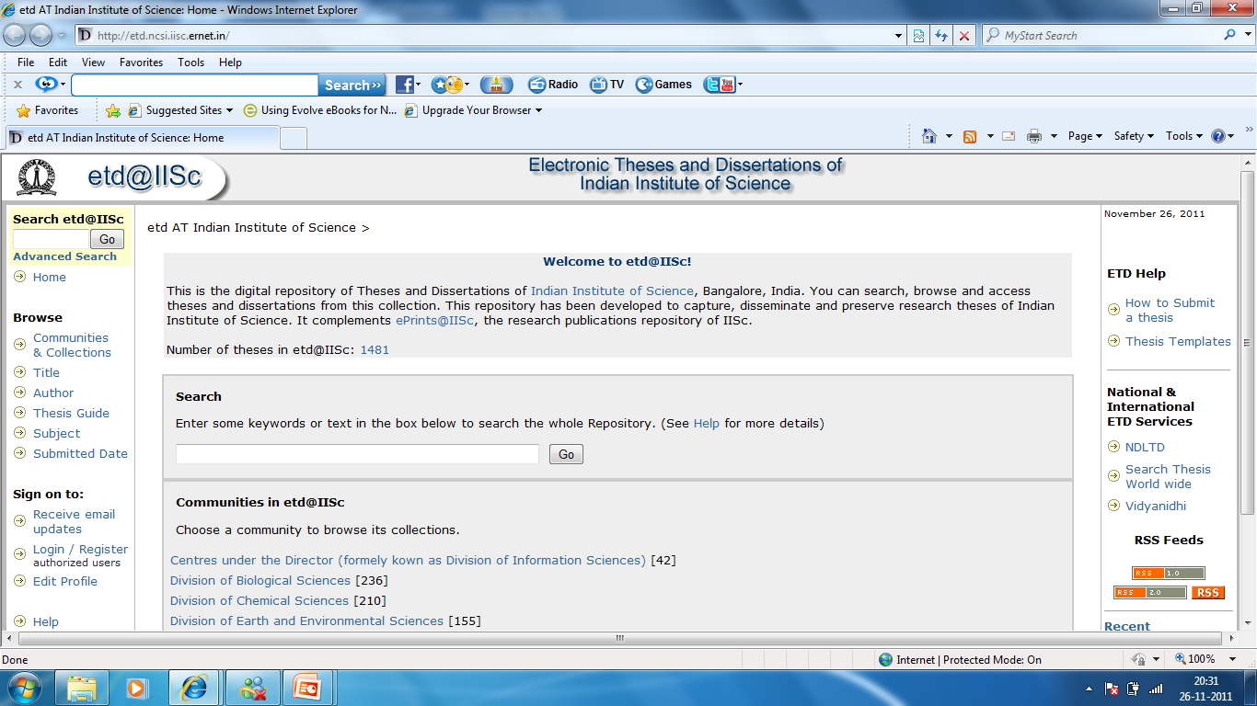

Slide 28
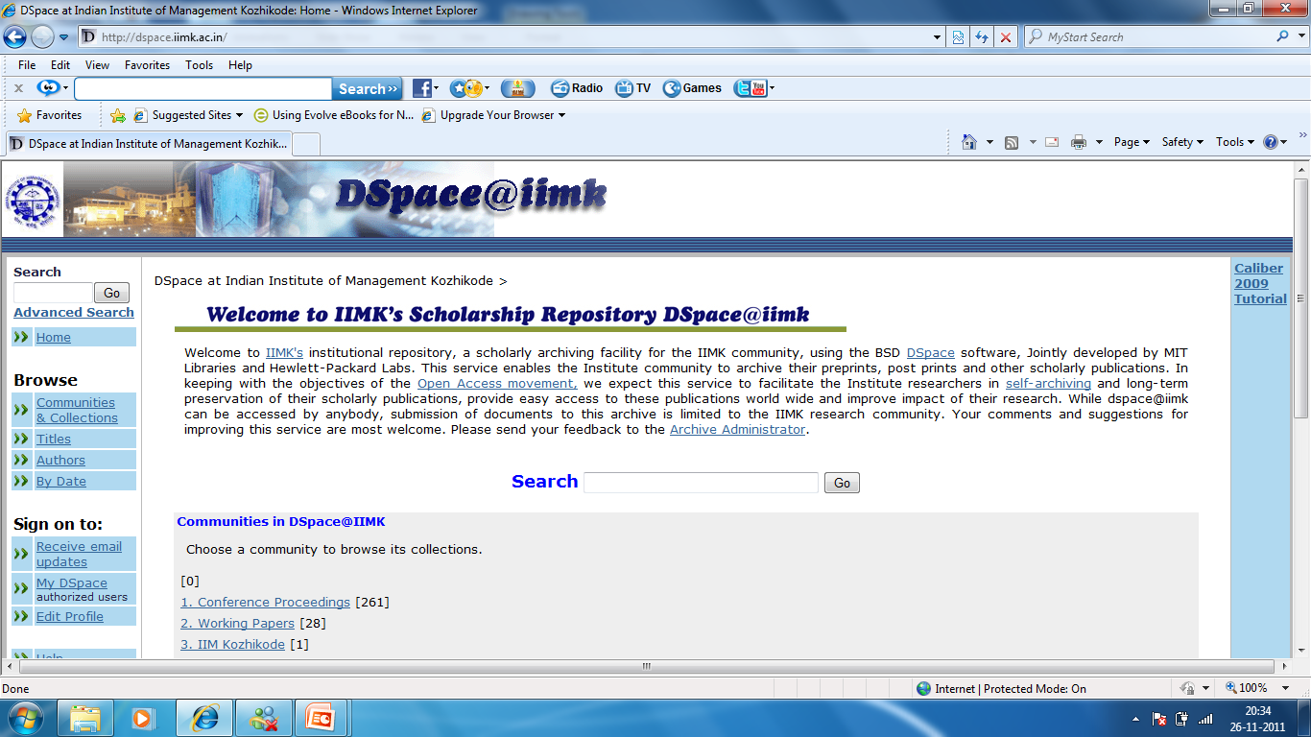

Slide 29
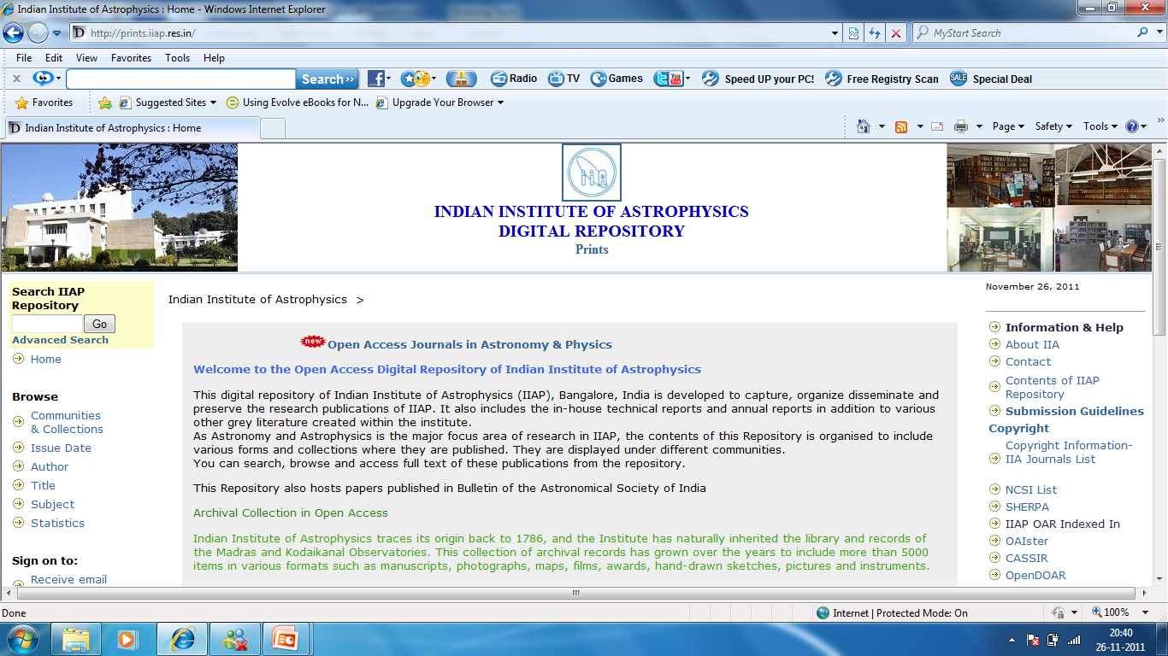

Slide 30
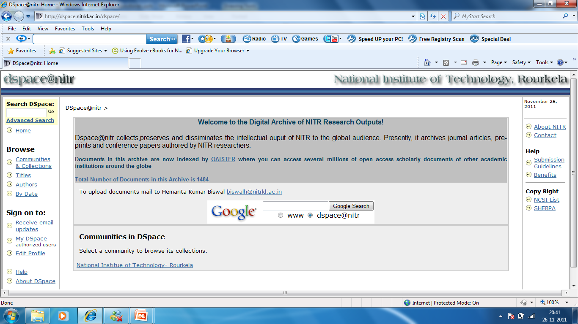

Slide 31
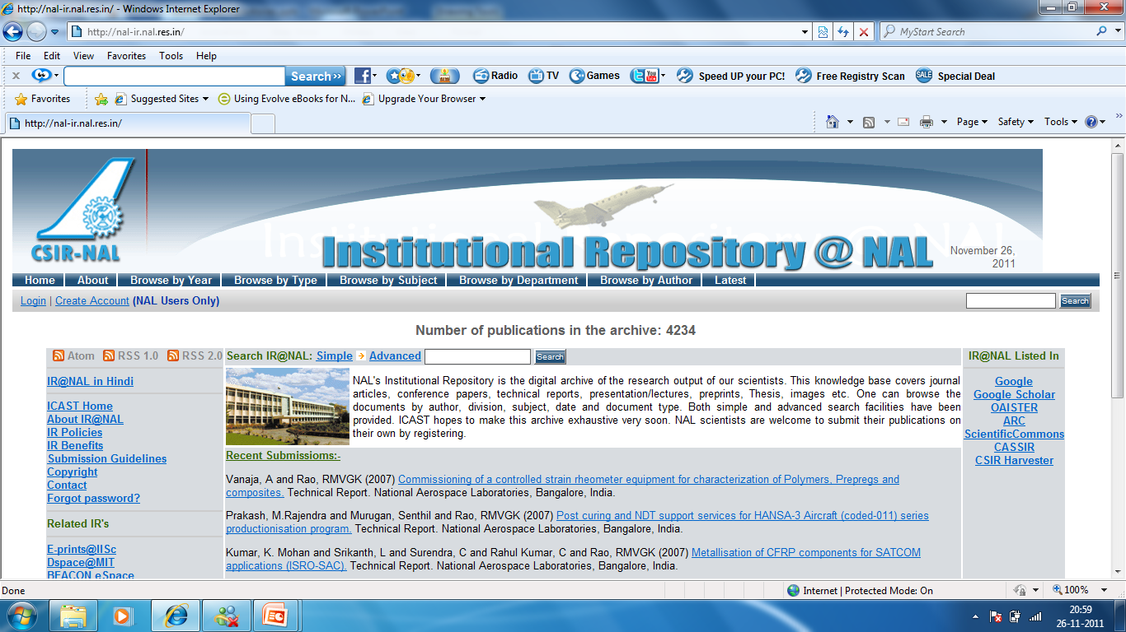

Slide 32
Directories of Open Access Repositories
OpenDoar (http://www.opendoar.org/)
ROAR (http://roar.eprints.org/)
The University of Illinois OAI-PMH Data Provider Registry
(http://gita.grainger.uiuc.edu/registry/Info.asp)
Openarchives.eu
(http://www.openarchives.eu/home/home_do.aspx)
OpCit: The Open Citation Project
(http://opcit.eprints.org/opcitabout.shtml)
RoMEO (Rights MEtadata for Open archiving (http://romeo.eprints.org /publishers.html)

Slide 33
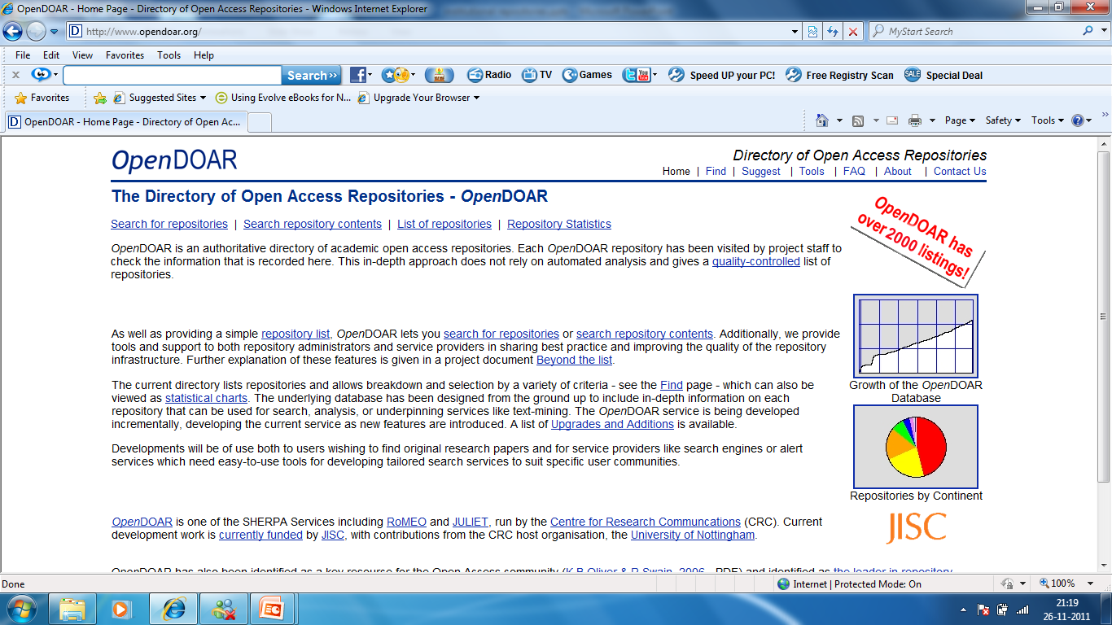

Slide 34
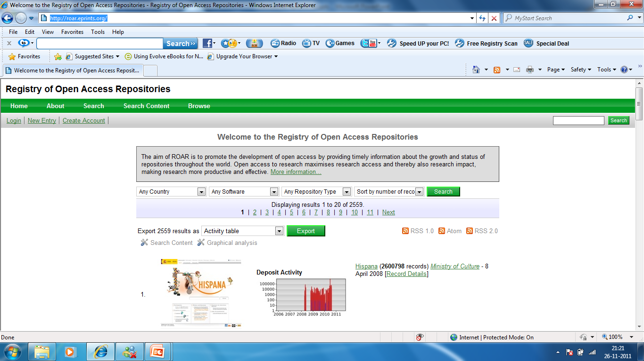

Slide 35
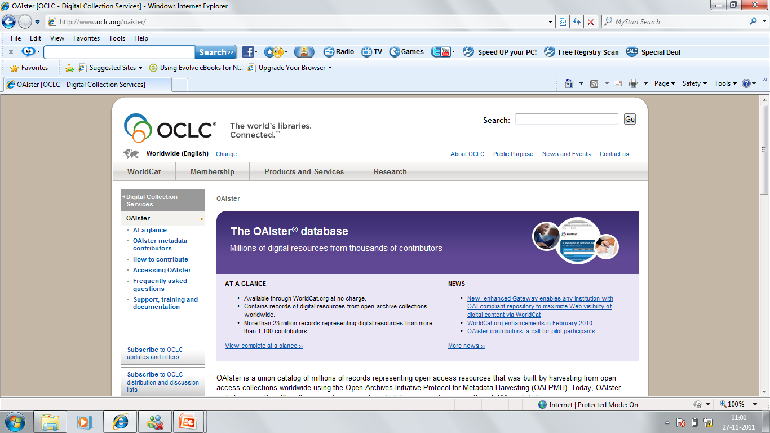

Slide 36
How does IR work
Research material is hosted and managed on an Institutional Repository server, using appropriate IR software
Accessible on the organizational LAN (intranet) + Internet/private network
Scientists use a web browser to submit (deposit) research material and also search the repository
Through OAI inter-operability protocol, a central search service ‘Harvests” metadata from individual IR’s, builds a cross-index and provides single point cross-repository search service
Security concerns could be handled at network, IR and publication level

Slide 37
IR Technology
IR software (Open Source/Commercial)
OAI-PMH harvesting protocol/software (Free)
Intel/Pentium servers for IR
Linux/Red Hat OS, MySQL/PostGress DBMS, Apache/Tomcat web server, Perl/Java (Free)

Slide 38
OAI-PMH harvesting protocol
It collects the OAI base path of the Inst.Repositories and passes it to the various OAI registries like – ROAR. OAI harvests can follow this registered path and retrieve the metadata for their own searching and indexing services.

Slide 39
IR: Core Issues
Policy Decisions
Organizational Issues
Cultural Issues

Slide 40
Policy Decisions
Scope
- Multidiscipline / single subject /Entire research output /database for each functional unit
Types of documents
- Single database for different types /single one
Software: OSS like DSpace or GNU Eprints or develop own
Research Deposit Types: Thesis, Journal articles, Preprints, Reports, Conference papers, Book Chapter, etc
Resources: Human (IT, Library), Servers, Funding
Stake holders: Library, Each Department, Institute as a whole
Services

Slide 41
Management and Organizational Issues
Deposit options
- Researcher self deposit and /or assisted deposit
Metadata quality
- Ensuring quality and rich metadata is labour intensive
Mandatory metadata fields
Digitization: Born digital / Scanning
File formats: Accept all, Only PDF and/or other, Conversion
Only full text database and/or Bibliographic
Copyright: RoMeO (Rights MEtadata for Open archiving (http://romeo.eprints.org /publishers.html) Publishers Copyright policies
Quality assurance: Peer review, Editing
Deposit Agreement and Use Agreement
- Depositor’s declaration: Non-exclusive license - Copyright/Patent/Trademarks
Repository’s rights and responsibilities: Distribute, Store, Migrate, Copy , Rearrange, Remove
- Use Agreement: Copy, Distribute, Display, Share, Author credit

Slide 42
Cultural Issues
Advocacy
- Sensitive to organizational culture and background
- Community size
- Strategy: stakeholders, management committees
Copyright
- Concern of researchers, Legal department
Positioning
- Library/Institute Website

